Slide 1

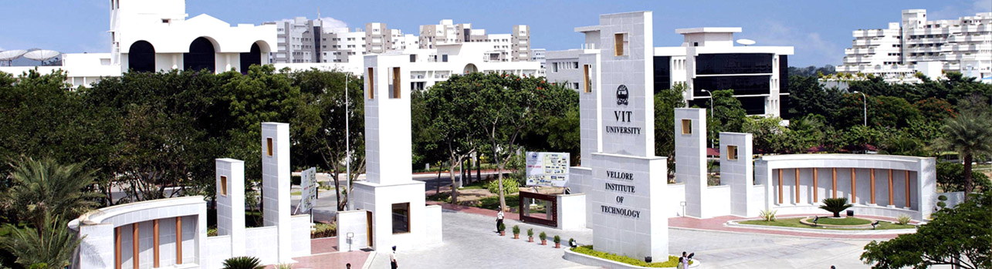
Brain-Computer Music Interface for Prosthetic Hand
Nagarjun Vinukonda - 15BME0458
B. Tech. Mechanical Engineering
Final Review Presentation
School of Mechanical Engineering
Prof. Ramakrishnan R
Project Guide
Mr. Eduardo R Miranda
External Guide
Organization
03-07-19

Slide 2
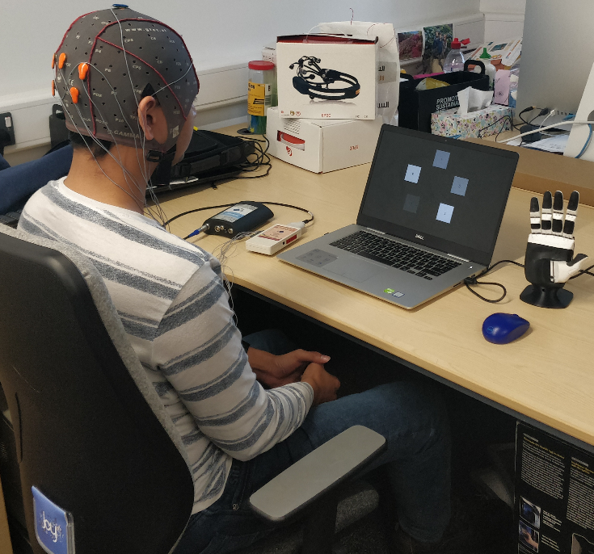
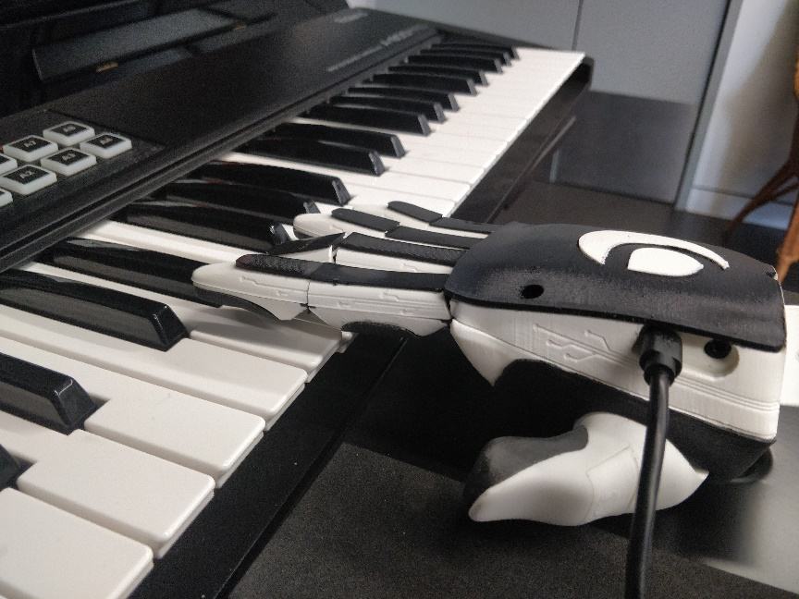
CONTENTS
Objective & Scope
Introduction
Literature Review
Knowledge gained
Gaps identified in the Research Area
Equipment
Methodology & Experimental procedure
Signal Acquisition
CCA
Results & Discussion
Future scope
Work plan
References

Slide 3
Objective & Scope
This project aims to develop BCMI system to read EEG (Electroencephalogram) of the brain and control the Open Bionics Brunel hand by use of SSVEP (Steady State Visually Evoked Potential) method, which enables people with severe motor impairment play musical instrument such as a Keyboard or Drum.

Slide 4
Introduction
A (BCI)Brain Computer Interface system is a communication system that reads brain activity converts it into commands for a computer or other devices.
There are different ways for acquiring brain signals, these are classified into invasive and non-invasive techniques.
The EEG based BCI are used with following four methods: (i) the P300 response (ii) slow cortical potential (iii) motor imagery (iv) steady-state visual evoked potentials (SSVEP).
This study uses SSVEP (Steady State Visually Evoked Potential), when gazed at the flashing regions on screen at different frequencies also called as stimuli as shown in below figure.
The specific frequency component of the source flashing on screen will increase in the EEG (Electroencephalogram) being measured and gives better SNR (Signal to Noise ratio) over the occipital lobe.
Hence, while gazing at different flashing regions where each of them represents a predefined command, after the signal processing and statistical analysis the command to actuate the prosthetic hand is given by gazing onto the screen. The analysis can either be done by CCA or by using FFT, preferably including also the harmonics.
Why SSVEP?
Because it has high ITR and Accuracy than others.

Slide 5
Literature Review
Title of the paper | Journal & Year | Authors | Significant Outcomes | Critical Remarks
Brain–Computer Interfaces Based on Visual Evoked Potentials | IEEE Engineering In Medicine And Biology Magazine, 2008 | Yijun Wang, Xiaorong Gao, Bo Hong, Chuan Jia and Shangkai Gao | Advantages of SSVEP over other BCI systems | The experiment is done on SSVEP method, based on its results, theoretically advantages over other methods is determined
Design and Implementation of a Brain-Computer Interface With High Transfer Rates | IEEE Transactions on Biomedical Engineering, 2002 | Ming Cheng, Xiaorong Gao, Shangkai Gao, and Dingfeng Xu | Approaches to improve SSVEP Based systems are discussed | The results of the experiment conducted are less accurate. Based on it theoretical assumptions are made to improve the SSVEP.
Dry and Water-Based EEG Electrodes in SSVEP-based BCI Applications | International Joint Conference on Biomedical Engineering Systems and Technologies, 2013 | Vojkan Mihajlovi C, Gary Garcia Molina, and Jan Peuscher | Based on the experimental analysis that has been concluded gel, followed by wet and then dry based electrodes show better accuracy in descending order. | These results shows better electrodes for application of BCI, but doesn't determine individual advantages followed by dry is more used than wet.

Slide 6
Knowledge Gained from the Literature
Advantages of SSVEP over other BCI systems.
Approaches to improve SSVEP Based system.
Based on the experimental analysis that has been concluded gel, followed by wet and then dry based electrodes show better accuracy in descending order.
About BCI
OpenVibe
Different Methods used for EEG detection of brain
SSVEP
Signal Processing

Slide 7
Gaps in the Literature
The experiment is done on SSVEP method, based on its results, theoretically advantages over other methods is determined.
The results of the experiment conducted are less accurate. Based on it theoretical assumptions are made to improve the SSVEP.
These results shows better electrodes for application of BCI, but doesn't determine individual advantages followed by dry is more used than wet.

Slide 8
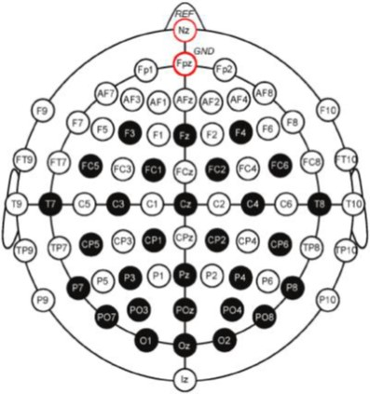
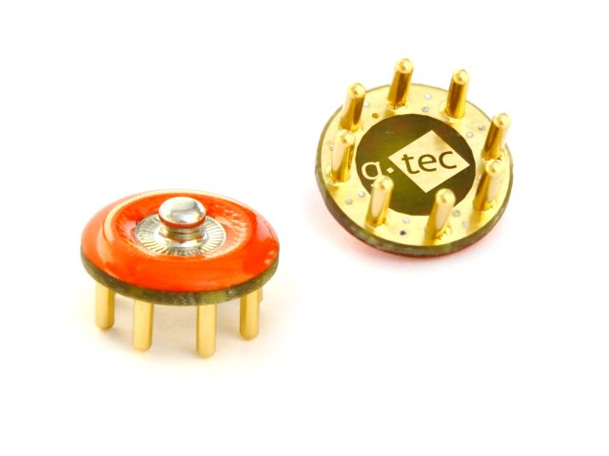
Equipment
The research has been done using following materials and their images are displayed below:
• Stimulus/flickering regions
• Openvibe
• g.tec Sahara Box Fig. 2.1
• g.tec Mobilab+ Fig. 2.2
• g.tec GAMMcap Fig. 2.3
• LSL (Lab Streaming Layer)
• MATLAB
• Psychtoolbox
• Openbionics Brunel hand 2.0 Fig. 2.4 Fig. 2.1 Fig. 2.2
Fig. 2.4
Fig. 2.3

Slide 9
Methodology & Experimental Procedure
In order to achieve the targets of this research, the following tasks have been broken down:
Acquisition and recording of EEG signals
Streaming EEG signals to filter
Filtering of EEG signals
Processing the filtered signals using CCA.
Sending the output to hand using Serial Communication.
Actuating the hand based on gazed target frequency

Slide 10
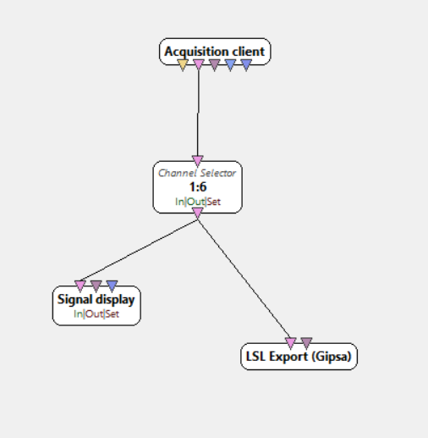
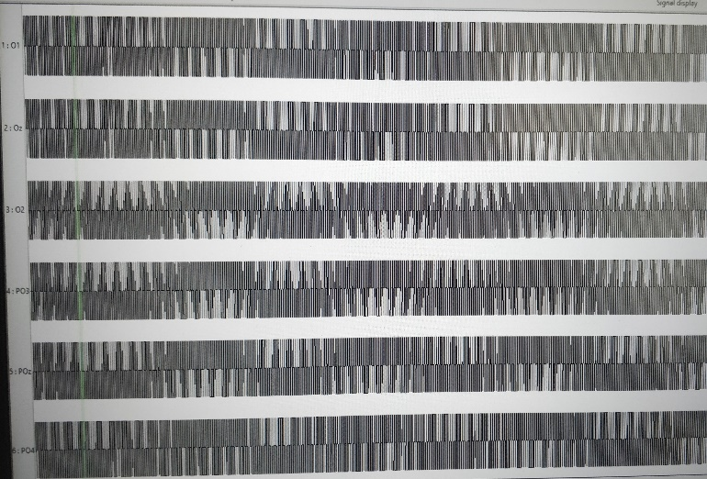
Signal Acquisition:
By using Openvibe software along with MATLAB scripting box I am able to read EEG data from EEG cap and send it into MATLAB. I have used O1, O2, PO3, PO4, POz electrode channels for EEG data extraction; The Openvibe boxs are as follows in images:
Firstly, EEG data are recorded with a sampling rate of 256 Hz with the g.SaharaBox and amplified using g.Mobilab+ devices.
The image above shows the process of data acquisition from EEG CAP and applying filter, later exporting it to MATLAB by LSL.
The image below shows the configuration of applied raw EEG data.

Slide 11
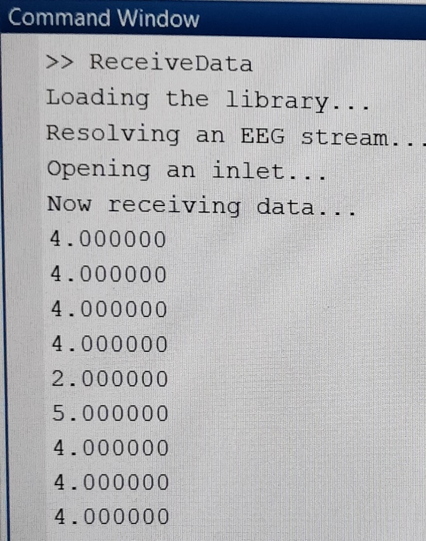
Canonical Correlation Analysis
CCA is a multivariable statistical method used when there are two sets of data, which may have some underlying correlation.
CCA extends ordinary correlation to two sets of variables.
First, CCA finds a pair of linear combinations, called canonical variables, for two sets (each set consist of each electrode data), such that the correlation between the two canonical variables is maximized.
Then it finds a second pair, which is uncorrelated with the first pair of canonical variables but has a next highest correlation.
The process of constructing canonical variables continues until the number of pairs of canonical variables equals the number of variables in the smaller set.
The coefficients describe the correlation relation of the two sets and largest coefficient of multiple correlation coefficients is considered.
The output of CCA: Stimulus number

Slide 12
Results and Discussion
Stimulus. No. | frequency | Open Bionic hand action
1 | 8 | Thumb closes
2 | 9 | Index finger closes
3 | 10 | Middle finger closes
4 | 11 | Both little and ring finger closes
5 | 12 | Little, ring and middle finger closes
6 | 13 | Thumb, little and ring finger closes
This study uses an online-system, where it collects, processes and analyse the real-time data to compute the gazed target frequency on the screen as output.
After CCA in MATLAB the system outputs the CCA values, and max of this CCA values is resulted with its corresponding index of targeted flickering region.
Further, for a specific index number of target frequency resulted, a particular numerical digit is assigned which is sent as binary data from MATLAB to Arduino software through serial communication.
The Brunel hand is programmed to respond to the sent binary data into Arduino Serial Monitor.

Slide 13
Future scope:
1) Building feedback system:
We can able to increase no. of options for operating the prosthetic hand without increasing the noise.
2) EEG headset:
EEG data recorded also depends on user’s concentration which requires his/her comfort for wearing the headset. The design of the EEG headset such that it is more comfortable to wear and gain better data would be very useful than the headset which is currently being used that acquires better signal by squeezing the electrodes on the scalp.
3) Optimising signal processing:
The adoption Joint Frequency Phase Modulation (JFPM) technique that creates unique flashing stimulus flashing at different frequency and phase making it easy to identify leading to reducing noise. And, improving signal processing filters can also increase the SNR and BCI communication rates.
4) using Machine learning:
The SSVEP is not required much user training. But if training is done the results will be much better than non-training. By use of Machine learning the data acquired can be trained to get better result. Machine learning can also be used for getting optimal stimulus size, user specific time window and training to acquire better data to reduce different subjects variation while gazing at screen in performance.

Slide 14
Work Plan (Gantt Chart)
Tasks:
With use of Openvibe extract the signals and get the peak value (Phase 1 effort).
Create a transformation Algorithm to interface between output signals and prosthetic hand (Phase 2 effort).
Optimizing the total system (Phase 3 effort).

Slide 15
References
Reza Fazel-Rezai, Recent Advances in Brain-Computer Interface Systems, first edition, InTech, India, 2011.
Yijun Wang, Xiaorong Gao, Bo Hong, Chuan Jia and Shangkai Gao (2008), Brain–Computer Interfaces Based on Visual Evoked Potentials, IEEE Engineering In Medicine And Biology Magazine, Vol. 27 , No.5 , September-October, PP. 64 – 71.
Ming Cheng, Xiaorong Gao, Shangkai Gao, and Dingfeng Xu (2002), Design and Implementation of a Brain-Computer Interface With High Transfer Rates, IEEE Transactions on Biomedical Engineering, Vol. 49 , No. 10, October, pp. 1181 – 1186.
Vojkan Mihajlovi C, Gary Garcia Molina, and Jan Peuscher (2013), Dry and Water-Based EEG Electrodes in SSVEP-based BCI Applications, International Joint Conference on Biomedical Engineering Systems and Technologies, pp 23-40.

